Slide 1
Texturing

Slide 2
Introduction
In the last few lectures we have
Learned how to transform and display game objects
learned how to use lighting and materials with GLUT objects
This lecture we will
Introduce texture mapping
Look at loading and displaying textures

Slide 3
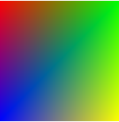
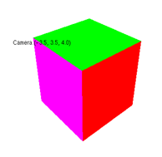
Patterned objects
As we have seen, OpenGL is a state machine
set the colour or material
everything we draw will have that colour or material until a new one is set
we could draw a multicoloured object by changing the materials for each polygon or groups of polygons
for example, a cube with different coloured faces
But this is tedious
and means we need a model with lots of polygons to show detailed colouring

Slide 4
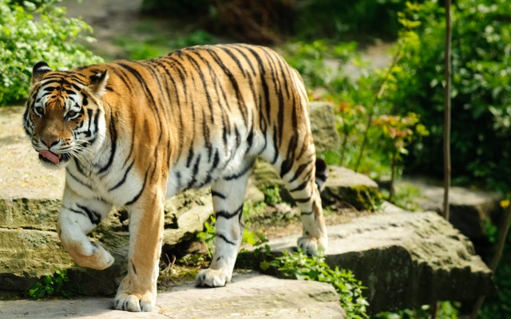
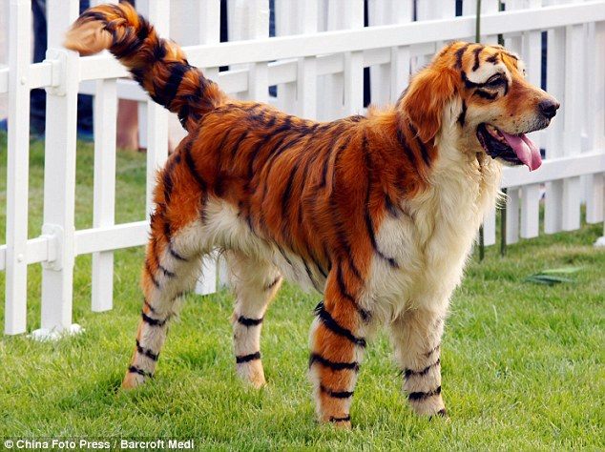
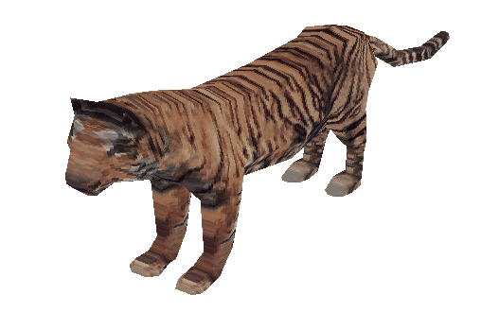
A tiger
A real tiger
A not so real tiger
A 3D model of a tiger

Slide 5
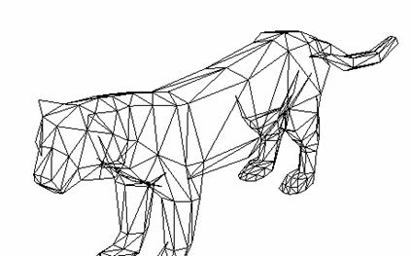
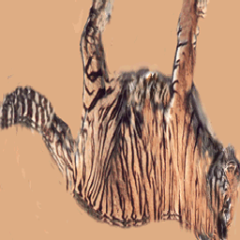
Texture Mapping
Instead of colours, we use textures
A graphic image (the texture) is mapped onto a polygonal model
Need to specify texture coordinates (u,v) for each polygon vertex
Interpolation is used to determine the (u,v) of each rendered pixel by
The texture image is also digital
each colour value is a texel

Slide 6
Lighting and textures
Can use textures with or without lighting
Without lighting, the texture will be blended with the current drawing colour
normally use white
With lighting, the texture will be blended with the colour generated by the lighting model
Normally use a white material

Slide 7
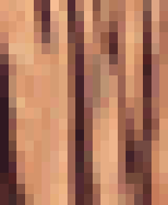
Aliasing in Texture Mapping
Minification
texture map too detailed
several texels map onto one pixel
object may shimmer as it moves
same pixel maps to different texels
Magnification
texture map too coarse
one texel maps onto several pixels
blocky image

Slide 8
Sampling texture maps
point sampling
use colour at pixel projection point
bilinear filtering
average 4 nearest texels
smooths out mismatch between pixel and texel size
circular, random filters
use mip-maps instead of averaging more texels as the model gets further from the viewer

Slide 9
Mip-mapping
"multum in parvo"
Latin for “much in little"
Pre-compute hierarchy of texture maps of different resolutions
When rendering, use the one which most closely matches the pixel resolution
e.g. highest level mipmap 512 x 512 texels
next level average blocks of four texels to get new texel colour
this map 256 x 256 texels
next level 128x 128 texels
to 1x1 texel
single colour for applying to objects projecting onto single pixel

Slide 10
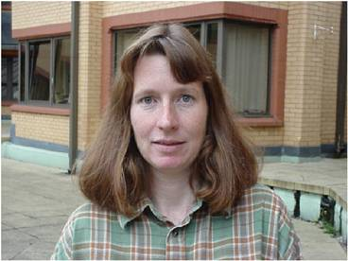
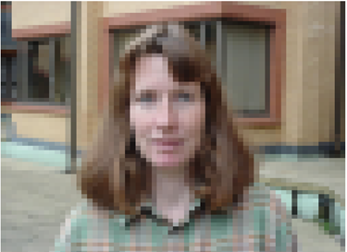

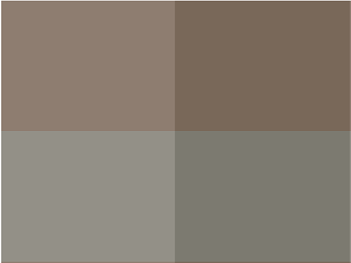
Example
1024 x 1024
64 x 64
16 x 16
2 x 2

Slide 11
Texturing in OpenGL
Need a file containing the texture (image)
The simplest file to read has the colour data only
.raw format
Grey value (black & white image) or rgb(a) colour values
0 to 255 unsigned ints, or 0.0 – 1.0 colours
There will be one colour value for each texel
Typically the image will be square, can lead to performance gains
for example, 512 x 512

Slide 12
Review: File Handling
last year you learned to read text data from a file
File I/O is a five step process:
Include the header file fstream.
Declare file stream variables.
Associate the file stream variables with input / output sources.
Use the file stream variables with <<, >> or other input / output functions.
Close the file

Slide 13
Binary files
All input/output is based on the concept of a stream.
A text stream is a sequence of characters composed into lines, each line is terminated with a newline (\n) character.
A binary stream is a sequence of unprocessed bytes - newline has no significance.
image files are usually in binary form
operations are similar for both
binary files are opened with a ios::binary flag

Slide 14
Binary output example
to write length characters to a binary file from an array data:
ofstream outputFile;
outputFile.open("output.dat", ios::binary);
outputFile.write(data, length);
outputFile.close();

Slide 15
Reading a file
it would be good to be able to allocate an array big enough to hold all the data in a file
but how can we determine how much data there is?
istream has a read pointer which holds the location of the next byte to be read
tellg() returns this location
seekg() moves the pointer to a given location
so:
open the file
move the pointer to the end of the file
get the location in bytes – that's the file length
create an array to read into of the required size
move the pointer back to the beginning of the file and start processing

Slide 16
Binary input example
ifstream inputFile;
int length;
char * data;
inputFile.open("input.dat", ios::binary );
inputFile.seekg (0, ios::end);
length = inputFile.tellg();
inputFile.seekg (0, ios::beg);
data = new char[length];
inputFile.read (data,length);
cout.write(data, length);
inputFile.close();

Slide 17
Class for Texture data
class Texture2D
{
private:
GLuint _ID; //Texture ID
int _width, _height;
public:
Texture2D();
~Texture2D();
bool Load(char* path, int width, int height);
GLuint GetID() const { return _ID; }
int GetWidth() const { return _width; }
int GetHeight() const {return _height; }
};
we will create a Texture2D class to load and store texture data

Slide 18
Reading in texture data
bool Texture2D::Load(char* path, int width, int height) {
char* tempTextureData; int fileSize; ifstream inFile;
_width = width; _height = height;
inFile.open(path, ios::binary);
if (!inFile.good()) {
cerr << "Can't open texture file " << path << endl;
return false;
}
inFile.seekg (0, ios::end); //Seek to end of file
fileSize = (int)inFile.tellg(); //Get current position in file - The End, this gives us total file size
tempTextureData = new char [fileSize]; //Create an new aray to store data
inFile.seekg (0, ios::beg); //Seek back to beginning of file
inFile.read (tempTextureData, fileSize); //Read in all the data in one go
inFile.close(); //Close the file
cout << path << " loaded." << endl;
glGenTextures(1, &_ID); //Get next Texture ID
glBindTexture(GL_TEXTURE_2D, _ID); //Bind the texture to the ID
glTexImage2D(GL_TEXTURE_2D, 0, 3, width, height, 0, GL_RGB, GL_UNSIGNED_BYTE, tempTextureData);
delete [] tempTextureData; //Clear up the data - We don't need this any more
return true;
}

Slide 19
Enabling textures
We need to turn texturing on
glEnable(GL_TEXTURE_2D);
Then we need to load the texture from disk
Texture2D* texture = new Texture2D();
texture->Load("Penguins.raw", 512, 512);

Slide 20
Binding and configuring the texture
First we set the bind the texture we want to use
glBindTexture(GL_TEXTURE_2D, _texture->GetID());
Then we must set some parameters so it renders correctly
glTexParameterf(GL_TEXTURE_2D, GL_TEXTURE_MIN_FILTER, GL_LINEAR);
glTexParameterf(GL_TEXTURE_2D, GL_TEXTURE_MAG_FILTER, GL_LINEAR);

Slide 21
Drawing the textured square
We can then render the texture by giving each vertex a corresponding TexCoord
glBegin(GL_QUADS);
glTexCoord2f(0.0f, 0.0f);
glVertex3f(-0.5f, -0.5f, 0.0f);
glTexCoord2f(1.0f, 0.0f);
glVertex3f(0.5f, -0.5f, 0.0f);
glTexCoord2f(1.0f, 1.0f);
glVertex3f(0.5f, 0.5f, 0.0f);
glTexCoord2f(0.0f, 1.0f);
glVertex3f(-0.5f, 0.5f, 0.0f);
glEnd();

Slide 22
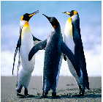
Texturing a square
A drawing colour has already been specified
normally white, but experiment!
Before specifying each vertex, specify its (u,v) texture coordinates
both u and v are normalized to the range 0 -> 1
regardless of the size of the image
Here we are mapping the corners of the image to the corners of the square

Slide 23

Texturing
normally we map only a small portion of the image to each polygon
glBegin(GL_QUADS);
glTexCoord2f(0.0f, 0.0f);
glVertex3f(-0.5f, -0.5f, 0.0f);
glTexCoord2f(0.4f, 0.0f);
glVertex3f(0.5f, -0.5f, 0.0f);
glTexCoord2f(0.4f, 0.4f);
glVertex3f(0.5f, 0.5f, 0.0f);
glTexCoord2f(0.0f, 0.4f);
glVertex3f(-0.5f, 0.5f, 0.0f);
glEnd();

Slide 24
Filtering methods
GL_NEAREST
point sampling – use the colour of the nearest texel
GL_LINEAR
use bilinear filtering
average 4 nearest texels – slower
specify separate filters for texture magnification (MAG_FILTER) and minification (MIN_FILTER)
Reset it back to GL_NEAREST_MIPMAP_NEAREST when drawing a non-textured object

Slide 25
Using textures
You will need to use a modelling tool to apply more than the most basic textures
They will export the u,v coordinates for each vertex
and the name of the texture file
each dimension should be a power of 2
16, 32, 64, 128, 256, 512, 1024
ideally square
the example code reads .raw files
binary file with triplets of r,g,b colour values
no header information
we will look at how to export and read files from a modelling tool in Week 8

Slide 26
Converting image files to .raw files
If you can’t save your texture to a .raw file, you will need to convert it
Use Photoshop!
The closest type is a .bmp or .tga file
.bmp has 54 header bytes of followed by uncompressed (b, g, r) triplets
http://en.wikipedia.org/wiki/BMP_file_format
.tga has 18 bytes of header information
http://en.wikipedia.org/wiki/.tga
Open the file, read in the header first then read in the RGB values
There may be useful information in the header you can use
See bmpReader.c or tgaLoader.cpp on Blackboard for an example
Be aware of the c-style file loading in BmpReader – convert it to C++!

Slide 27
Summary
This lecture we have:
Discussed texturing in OpenGL
Reading:
OpenGL Programming Guide (The Red Book)
Chapter 9: Texture Mapping
Practical:
texturing a square
experiment with texturing parameters

